Slide 1
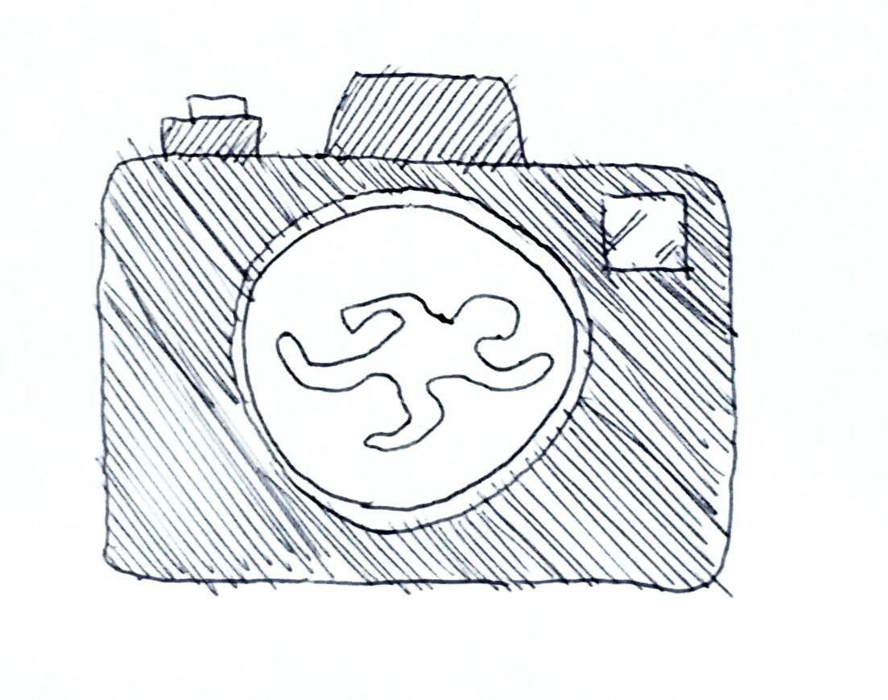

Pier 37: ID Hunters
Efficient Forensic Photos
Final Presentation
Find us at: https://theportatcern.github.io/Hackathon2016-Pier37/

Slide 2
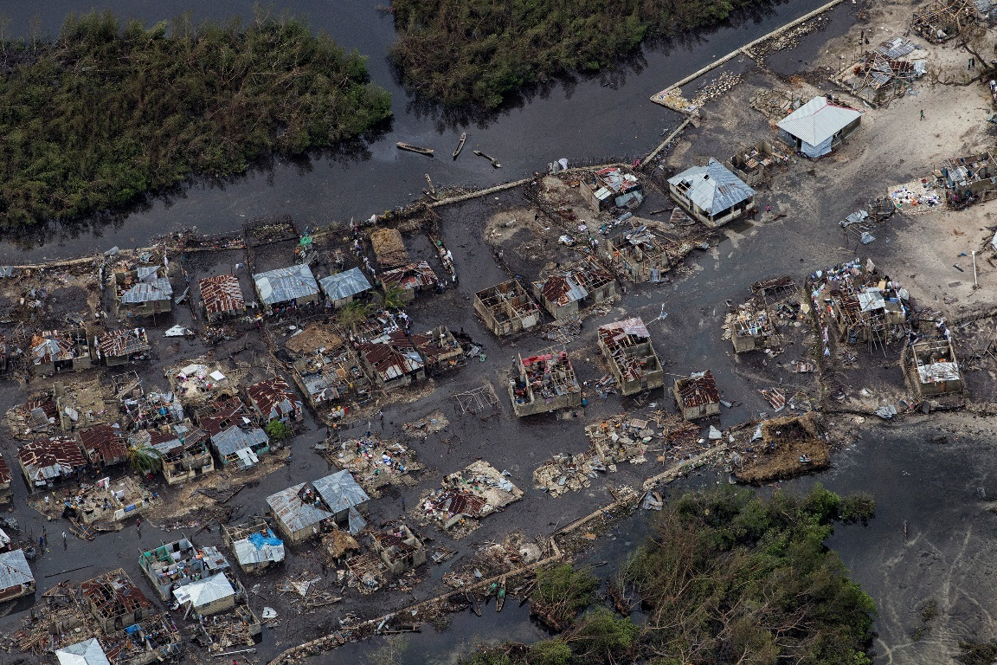
The context
Natural disasters with thousands of victims …
Aftermath of Hurricane Matthew, Haiti,
Oct 4, 2016

Slide 3
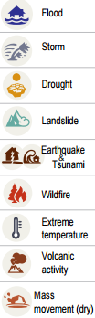
A forensic identification problem …

Slide 4
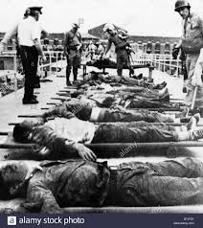
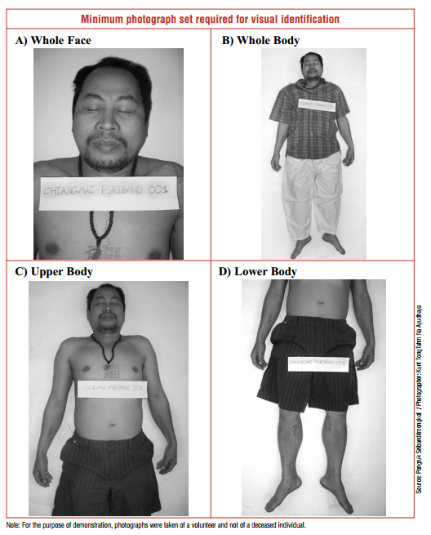
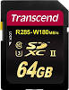

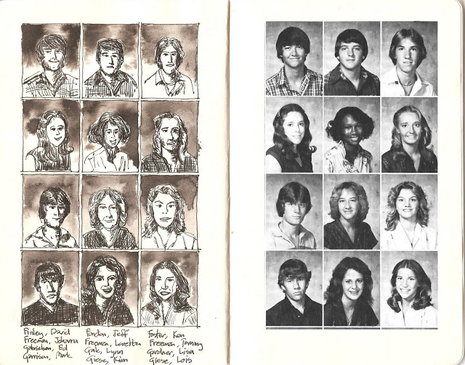
On-Site Bodies Collection
Morgue
Body cremation
Data collection
Family identification

Slide 5

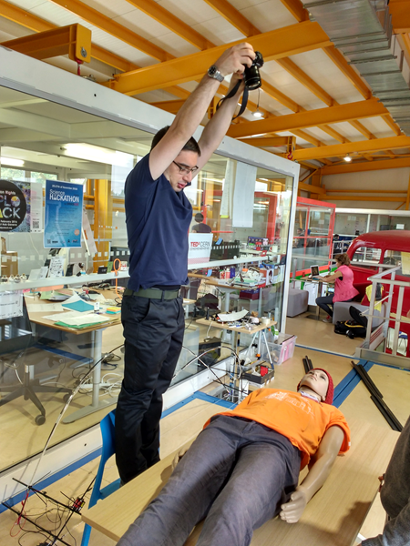

Body on table leads to issues in framing the full body picture.
Main issues:
Frame
Light
Focus
Stability

Slide 6
What we aimed for?
POrtable Photo Studio (POPS)
- A Forensic Photo
Toolkit
Notes:
Efficient forensic pictures are fundamental for body remains identification by family members and automation of downstream processes.
We need the following pictures:Whole face, Whole body, Upper body, Lower body

Slide 7
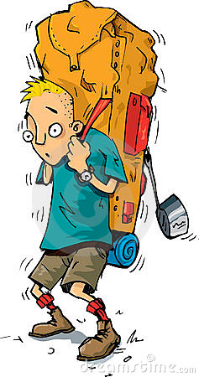
Constraints
Use existing cameras- all kinds of SLR Camera
Inexpensive readily-available components
Compact - fits in a normal size backpack
Easy to use by first responders (Police or Forensic Staff)
Adaptable and universal solution required

Slide 8
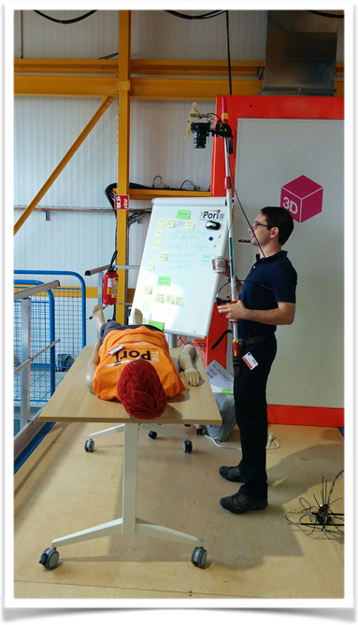
Stability while taking Pictures
Before
After

Slide 9
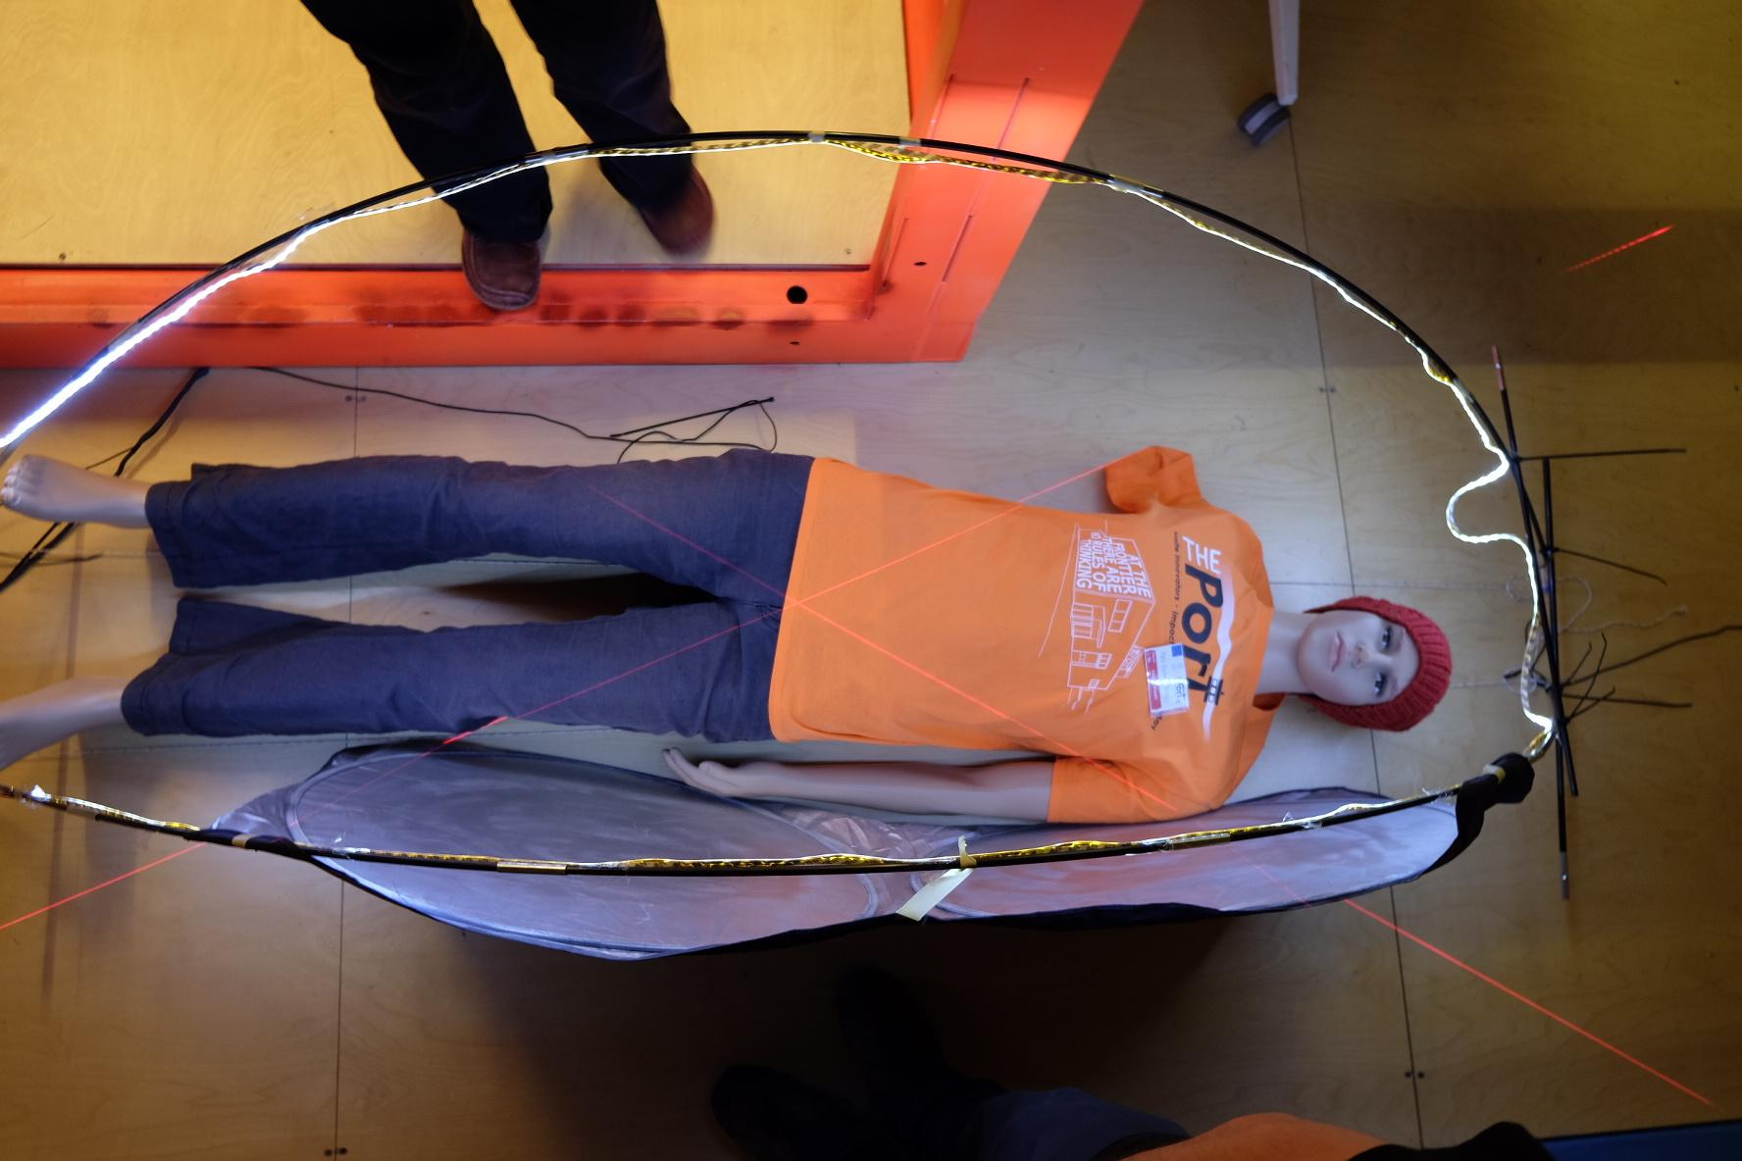
Lighting
Light and foldable structure
+
LED strip

Slide 10

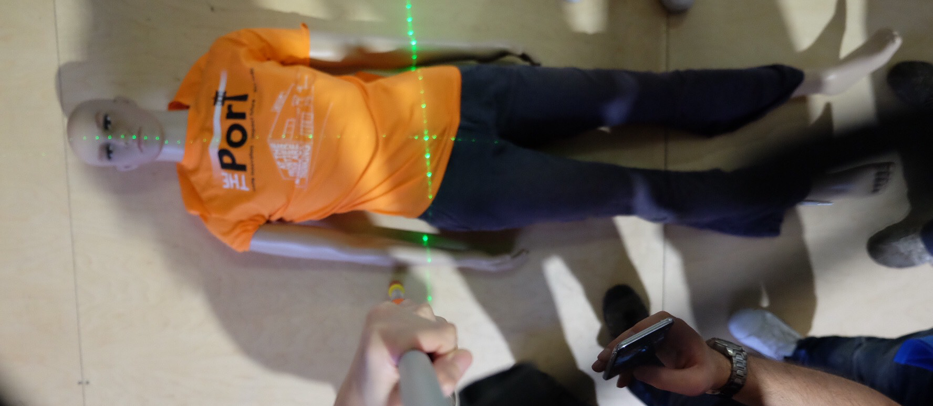
Laser framing
Framing using reference given by the laser
Can be used in the post-process phase to calculate dimensions

Slide 11

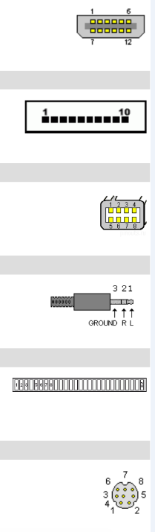

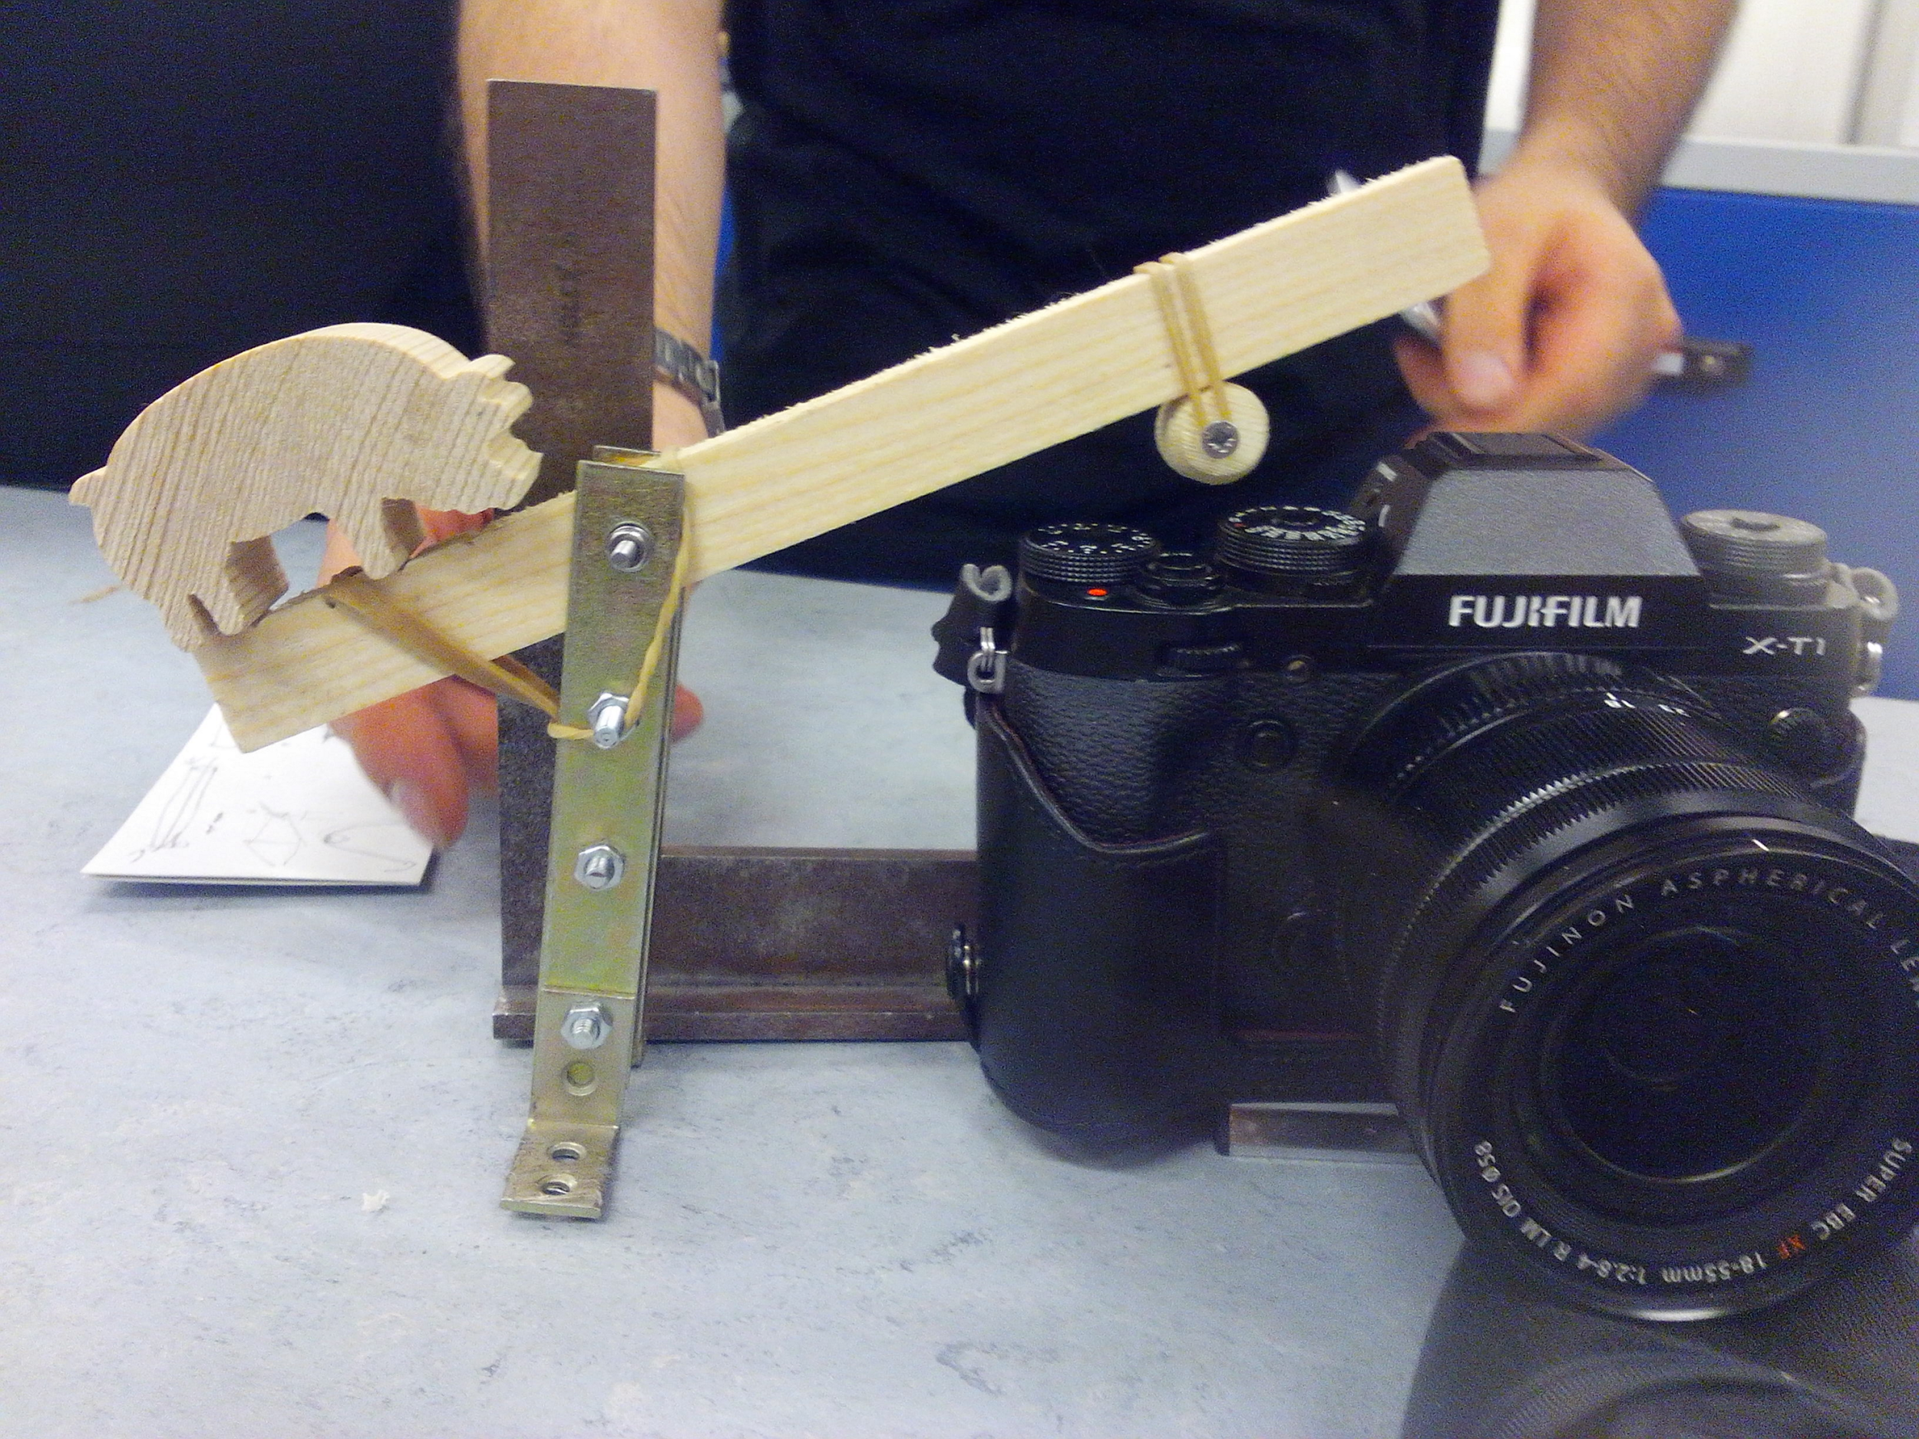
Analog trigger
Not all cameras have remote control, not universal
Camera is ~1.5m away
We need a universal mechanism to trigger the camera

Slide 12
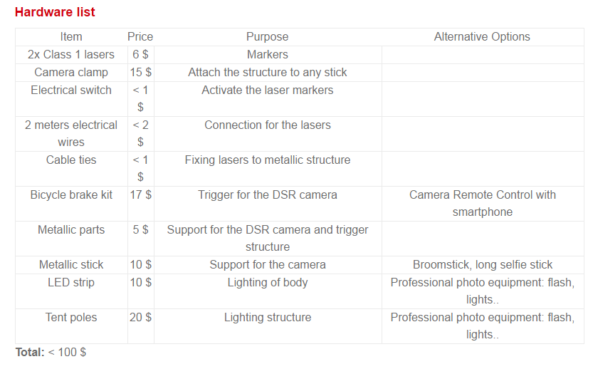
Resources
Instructions and material list available at https://theportatcern.github.io/Hackathon2016-Pier37/

Slide 13
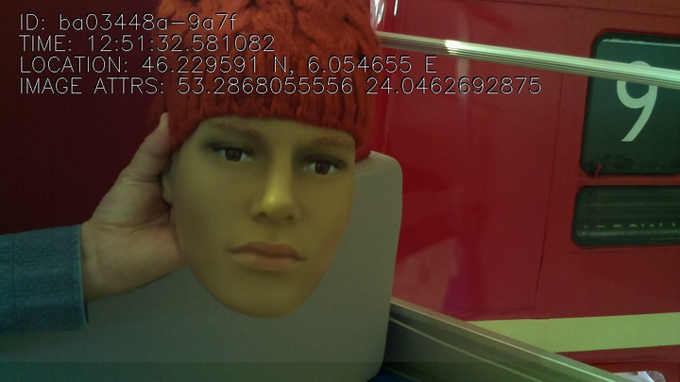
Future Ideas ...
Automatic matching of forensic pictures against the picture provided by family members
Post-processing: Auto-annotation of images with their detailed text description of body characteristics to expedite the documentation process followed by the forensic experts

Slide 14
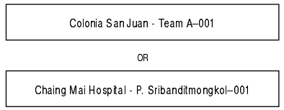

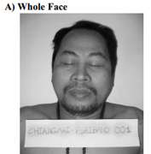
Post-Processing: Text extraction
Using Google Cloud Vision API
Colonia San Juan Team A-001
OR
Chaing Mai Hospital P. Sribanditmongkol-001
ColoniaSanJuanTeamA-001ORChaingMaiHospitalP.Sribanditmongkol-001

Slide 15
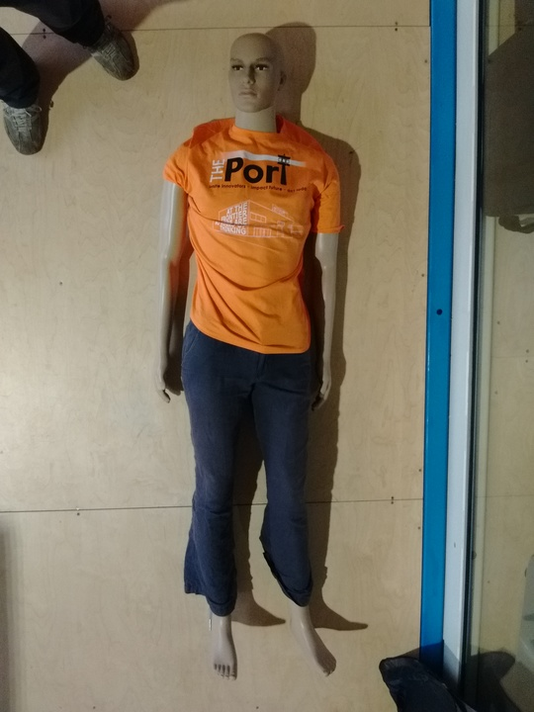
Post-Processing: Auto-annotation
Using Google Cloud Vision API
Clothing
Male
Muscle
Toy
t shirt

Slide 16

Thanks!
Questions?
Find us at: https://theportatcern.github.io/Hackathon2016-Pier37/

